Slide 1
IS216 Web Application Development II
Week 5
JavaScript – Part 3 (APIs, Axios, JSON)
K. J. Shim
Sections: G3/G4

Slide 2

Source Code Files & Tools
eLearn → Content → Week 5 → In Class → Week5_InClass.zip
Unzip it into:
Go to https://www.postman.com/downloads/
Sign Up (create an account)
Download and install locally on your computer.
Please do NOT use the browser version !!!
Later on, we will host API apps locally @localhost which is obviously only accessible locally (and thus inaccessible from the Internet).
<WebRoot> → is216 → Week5 → InClass

Slide 3
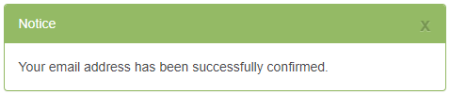
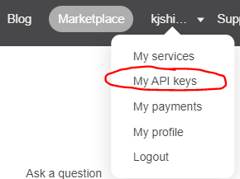
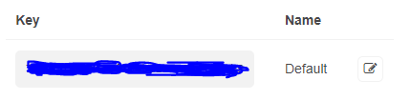
Tools (continued…)
Go to https://openweathermap.org/ and Sign Up → Verify Your Email
Sign In → (menu) → Click on your username → My API keys
You will see the default key → this is your API Key
It is NOT activated yet! It takes ~30 minutes to 1 hour. LATER today… You will need this API Key to programmatically CALL OpenWeatherMap.org’s weather API endpoints
Copy this API Key into a Sticky Note (or somewhere on your computer for easy access – Do NOT share it with others)
DO NOT SHARE WITH OTHERS

Slide 4



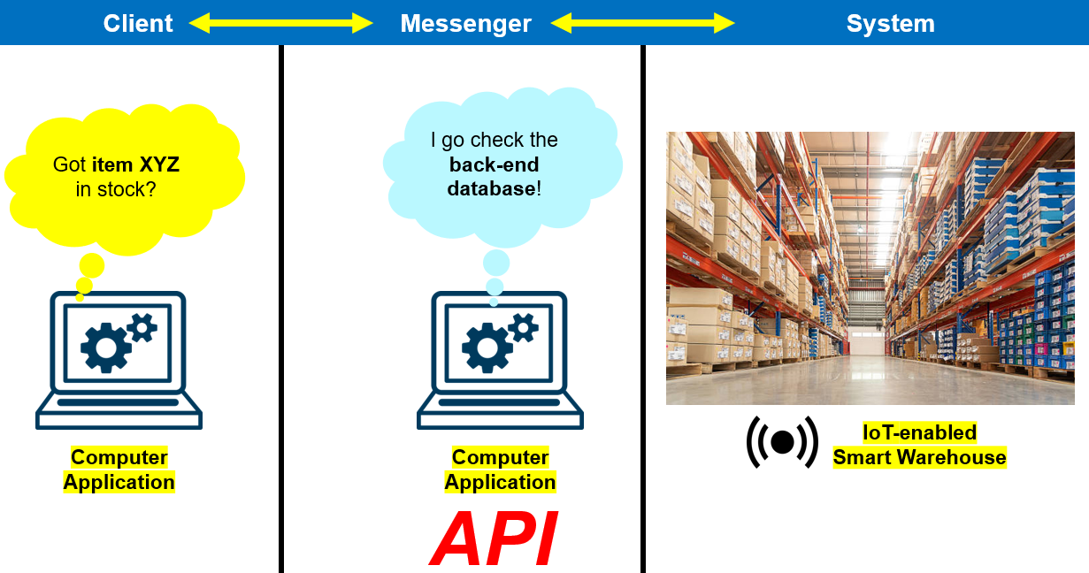
Agenda
APIs - Axios & Async HTTP requests - JSON Data Processing

Slide 5
Solution Architecture (in IS113)
Krazy Company, Inc.
Web Application
Front-End
Web Application
Back-End
MySQL
Database
CRUD
(Development) http://localhost/...
Front-End & Back-End are tightly coupled (belong to the same code base)
Web App & Database reside on the same server (yikes! Single point of failure…)

Slide 6
Solution Architecture (in IS216 - Phase 1)
Krazy Company, Inc.
“Client”
“Server”
1
Client sends an HTTP GET request
Web Application
Front-End
KrazyDating
API
MySQL
Database
READ
2
Server sends an HTTP response
(Development) http://server1…/...
(Production) http://server2…/krazydating/
(Production) Somewhere in AWS Cloud
https://...aws.../.../
Front-End Web App & API App are de-coupled
Front-End Web App & API App & Database are hosted in 3 different locations (no single point of failure)

Slide 7

Solution Architecture (in IS216 - Phase 2)
Krazy Company, Inc.
3rd party to Krazy Company, Inc.
“Client”
“Server”
Web Application
Front-End
KrazyDating
API
MySQL
Database
READ
API
https://openweathermap.org/
(Development) http://server1…/...
(Production) http://server2…/krazydating/
(Production) Somewhere in AWS Cloud

Slide 8
(Mac) My MAMP won’t start MySQL !!!
Open Terminal
Go to /Applications/MAMP/conf/
cd /Applications/MAMP/conf/
Open my.cnf
sudo nano my.cnf
You will see a line that points to some IS112 related folder path…
Go to the beginning of the line and put # (this will comment that line out)
You probably won’t repeat IS112 so it’s okay (or will you?)
Restart MAMP
You should see Start (GREEN) – indicating both Web Server & MySQL Server started successfully.

Slide 9
Things to Finish Before Week 6
Complete:
JavaScript – Part 3 (API, JSON & AJAX) – Challenges 13, 14, 15
Resource files (Bootstrap 5.2 version !!!) can be downloaded from this link (please replace Bootstrap CSS/JavaScript CDN with the latest V5.3)
[GitHub Pages – Personal Website]
Adding API keys inside of your GitHub Pages files would expose the keys to the public. This is not desirable.
eLearn → Content → Week 6 → Before Class
Watch the video
Complete Week 6: Pre-Class Quiz (Vue.js - Basics)

Slide 10
Questions? Need Help?
Join us in Slack
@
https://is216-oppa.slack.com
Thank You!

